Slide 1
Lesson 6: السادس الدرس
Welcome to Arabic Level I by Kurzban
Objectives:
Review
Arabic Numerals ( 1-10)
Practice
Summary
Discuss Homework: Herbs from the garden.

Slide 2

Lesson 6: Do NOW: Write an appropriate transliteration to each.
تين بيَّان ثِياب نَبِيذ بَارُود {1
رَتيب ثابِت زِرياب يَدان رَباب {2
نَعم لا{3

Slide 3
Lesson 6: Introduction to pronouns
أنا
انت
انت
هو
هي

Slide 4
Lesson 6: السادس الدرس
https://www.youtube.com/watch?v=vMDjF64mGLw
Islamic Civilization

Slide 5
Numerals Review!
واحد إثنان ثلاثة أربعة
____ ____ ____ ___
خمسة ستة سبعة ثمانية
___ ___ ____ ____
تسعة عشرة
___ ____

Slide 6

Let’s start
١ واحد

Slide 7

Let’s start
٢
إثنان

Slide 8

Let’s start
٣ ثلاثة

Slide 9
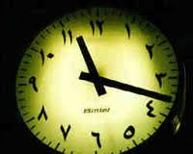
Let’s start
٤ أربعة
arbaa

Slide 10

Let’s start
٥ خمسة

Slide 11
Let’s start
٦ ستة

Slide 12
Let’s start
٧ سبعة

Slide 13
Let’s start
٨ ثمانية

Slide 14
Let’s start
٩ تسعة

Slide 15
Let’s start
١٠ عشرة

Slide 16
Lesson 6: Vocabulary
Look back at your notes and provide a definition for each
Try to add short vowels above the letters
السلام عليكم
اسمي
الى اللقاء /مع السلامة
انا

Slide 17
Lesson 6: Numbers السادس الدرس
A little background on Arabic numerals
Please read the article under the link below
http://www.unc.edu/~rowlett/units/roman.html

Slide 18
Numerals
The system of numeration employed throughout the greater part of the world today was probably developed in India, but because it was the Arabs who transmitted this system to the West the numerals it uses have come to be called Arabic.
Reference: http://www.islamicity.com/mosque/ihame/Ref6.htm

Slide 19
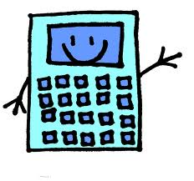
Let’s do some Math!
Write your responses in Arabic!
1] 2+ 5 = _______ ____________________
2] 8 – 4 = _______ ____________________
3] 10 – 5 = _______ ____________________
4] 7 + 2 = _______ ____________________
5] 10 – 7 = _______ ____________________
6] 2 + 6 = _______ ____________________
7] 9 – 8 = _______ ____________________
8] 2 + 8 = _______ ____________________
9] 4 + 2 = _______ ____________________
10] 6 – 4 = _______ ____________________
نعم
لا
و

Slide 20
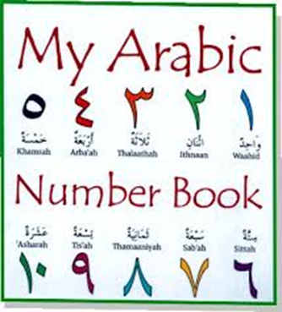
Summary
Take this quiz on line:
http://quizlet.com/2470196/test/

Slide 21
Feminine words
You have already seen that there are two genders in Arabic. All nouns ( people, objects, ideas, etc) are either masculine or feminine.
Luckily it is fairly easy to tell which gender a particular word is.
There is a special feminine ending that is a “ bundled up” [Ta], it’s called ta marbuta ( literally tied up ta) & it is not usually pronounced

Slide 22
Feminine words
There are two main categories of words which are feminine:
Female people or words that refer to females
Singular words that end in ta marbuta.
However, there are few exception this rule.
In general, you can presume a word is masculine unless it falls into on of the two categories above. More details on this topic later on….

Slide 23

Review
Review
Make your flash card for this lesson
Questions????

Slide 24
Lesson 6: Do NOW: Connect the letters and define the words.
Copy the following words down on a ruled sheet of paper. Remember that { ra, waw, & zay} descend slightly below the line, where {dal, thal} do not. Proceed from right to left.
رَذاذْ دُوَّار رِدادْ ذُرور

